Slide 1



Data Preprocessing Unsupervised learning
Elena Sügis
elena.sugis@ut.ee
Introduction to Bioinformatics, LVSC2016

Slide 2

?
?
?

Slide 3



Questions we ask
VS
VS
Notes:
can some of the diseases occur together, how different people react on drugs.
what genes are responsible for the disease development , how they are regulated and in what other processes they are involved.

Slide 4
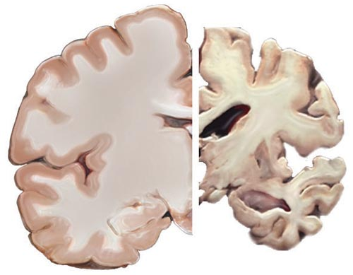
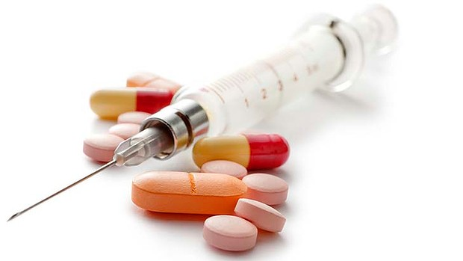
Questions we ask

Slide 5
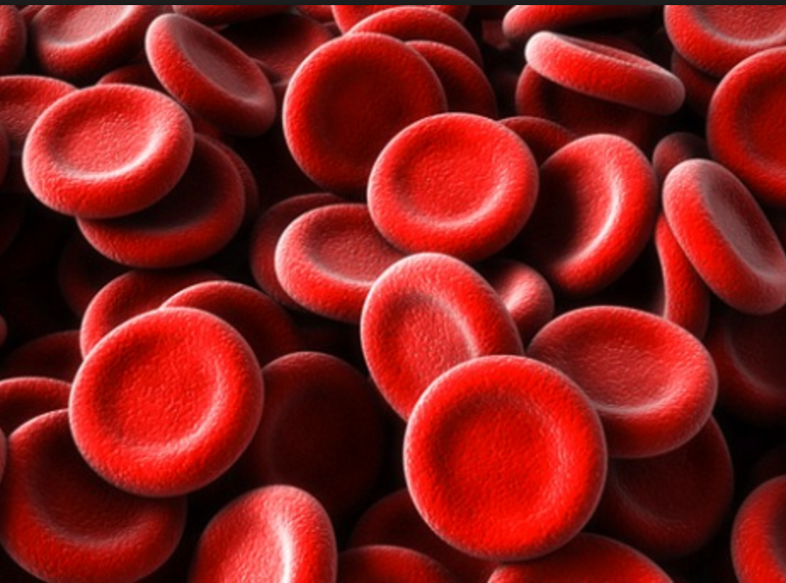
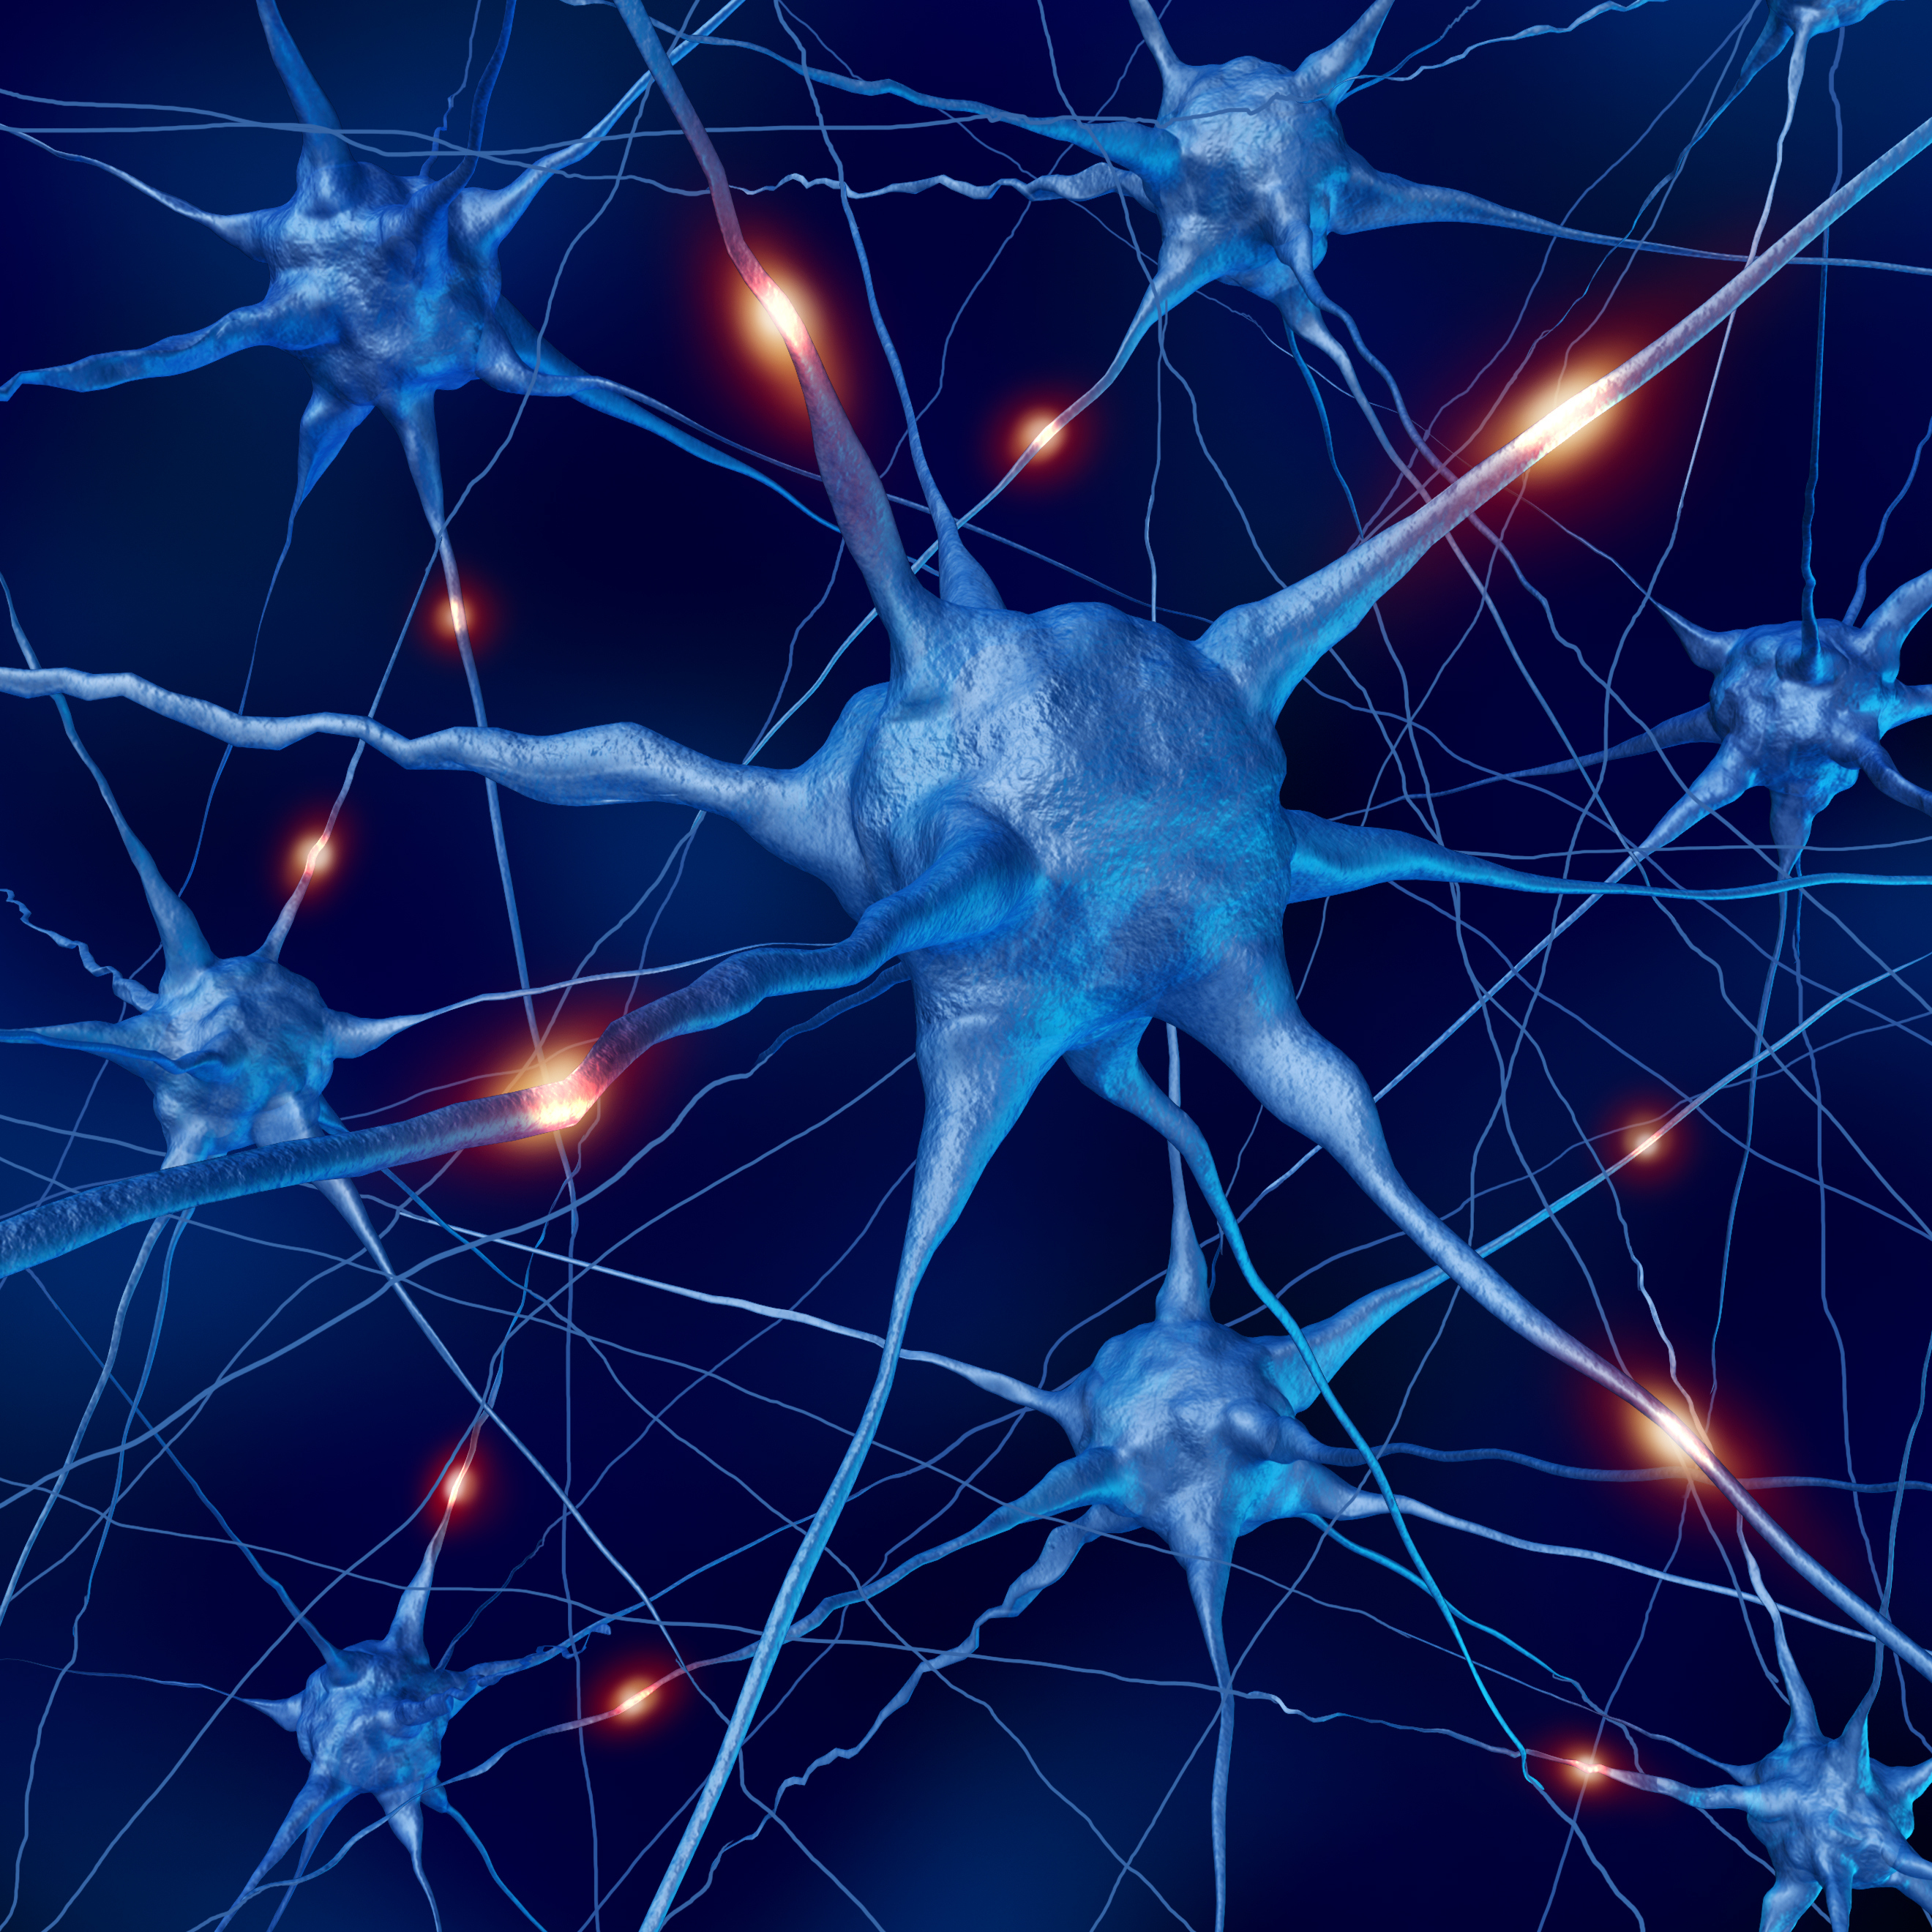
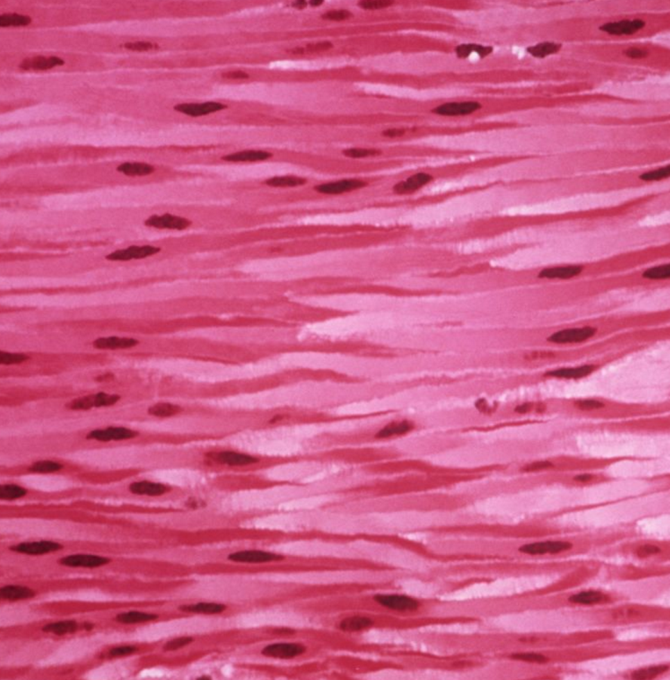
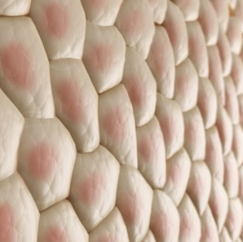
Questions we ask

Slide 6

Experiments

Slide 7
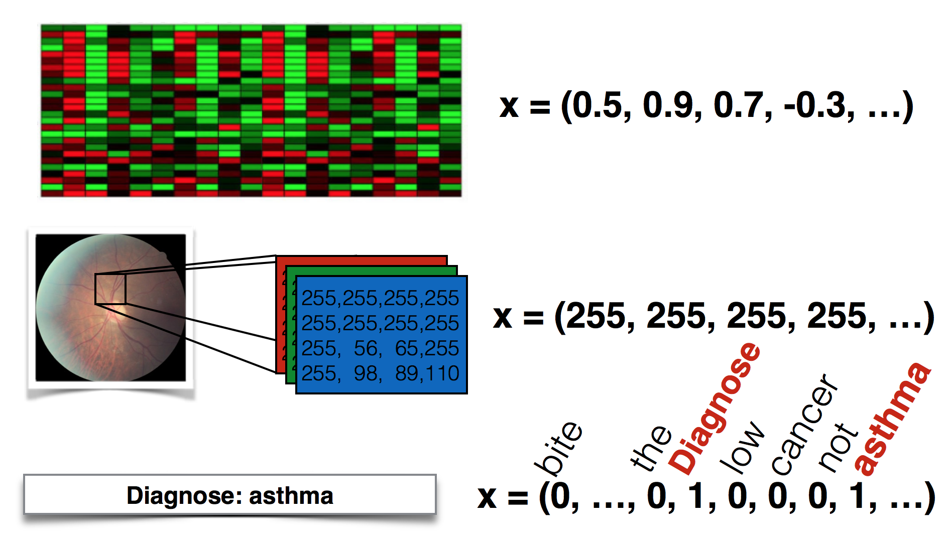
Data comes in different forms

Slide 9
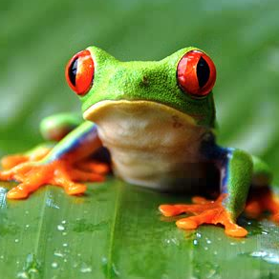

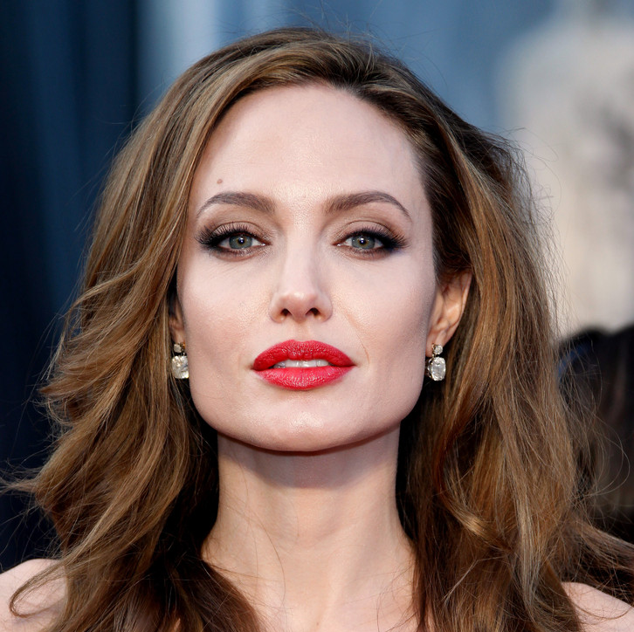
Simple data analysis pipeline
Data
Black Magic
Result
high quality data
machine learning
method
awesome result

Slide 10


Simple data analysis pipeline
Data
Black Magic
Result
poor quality data
machine learning
method
not so
awesome result

Slide 11

Data Preprocessing
Clean

Slide 12
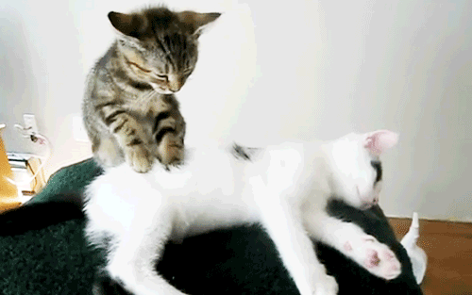
Massage your data

Slide 13

80 %

Slide 14
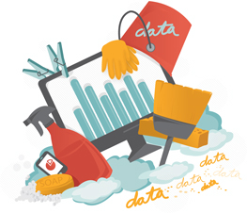
Interpretation
Import
data
validation
?
Data
analysis
Handle
outliers
Impute missing values
Normalize/
Standardize

Slide 15
Interpretation
Import
data
validation
Data
analysis
Summarize/
plot raw data
Handle
outliers
Impute missing values
Normalize/
Standardize

Slide 16
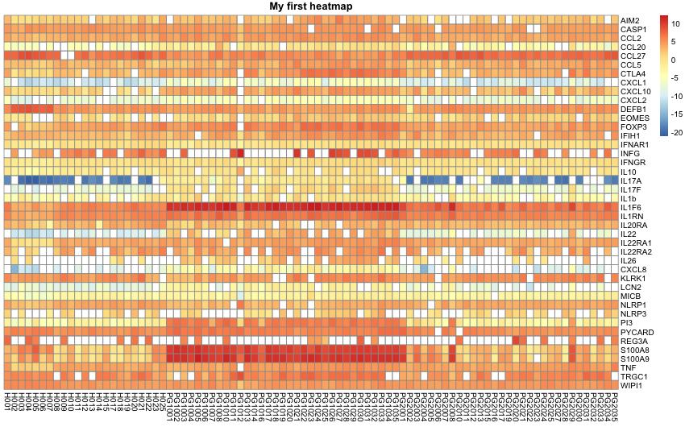
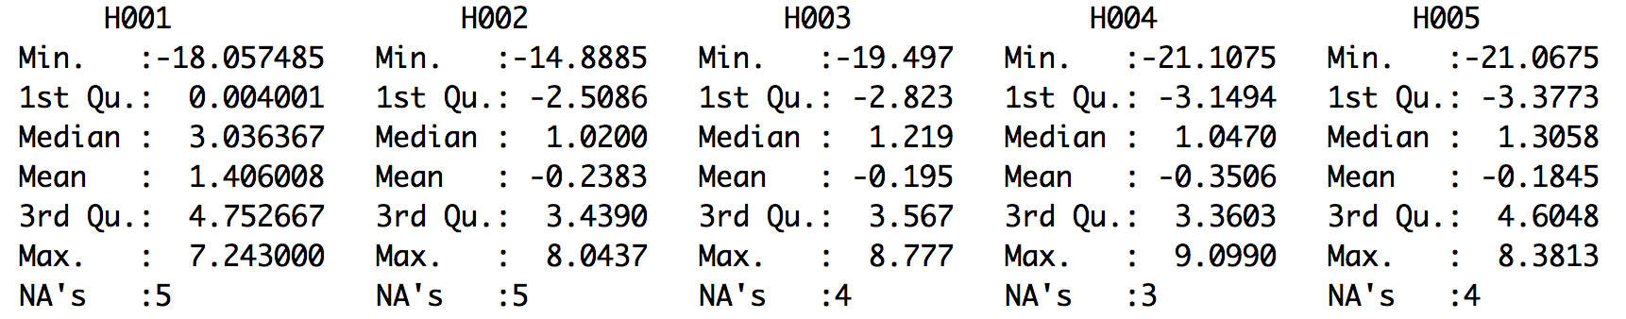
Meet your data

Slide 17
Interpretation
Import
data
validation
Data
analysis
Summarize/
plot raw data
Handle
outliers
Impute missing values
Normalize/
Standardize

Slide 18

Missing Values
Origins:
Malfunctioning measurement equipment
Very low intensity signal
Deleted due to inconsistency with other recorded data
Data removed/not entered by mistake

Slide 19
Missing Values
How to deal with them:
Filter out
Replace missing values by 0
Replace by the mean, median value
K nearest neighbor imputation (KNN imputation)
Expectation—Maximization (EM) based imputations

Slide 20

k-nearest neighbors

Slide 21
KNN
We are given a gene expression matrix M
Let X=(x₁, x₂, …, x_{i}, …, x_{n}) be a vector in the matrix M with a missing value at x_{i} at the dimension i
Find in the gene expression data matrix matrix vectors X1 , X2 , …, Xk , such that they are the k closest vectors to X in M (with a chosen distance measure) among the vectors that do not have a missing value at dimension i
Replace the missing value x_{i} with the mean (or median) of X1 _{i}, X2 _{i}, …, Xk _{i} , i.e., mean (median) of the values at dimension i of vectors X1 , X2 , …, Xk

Slide 22
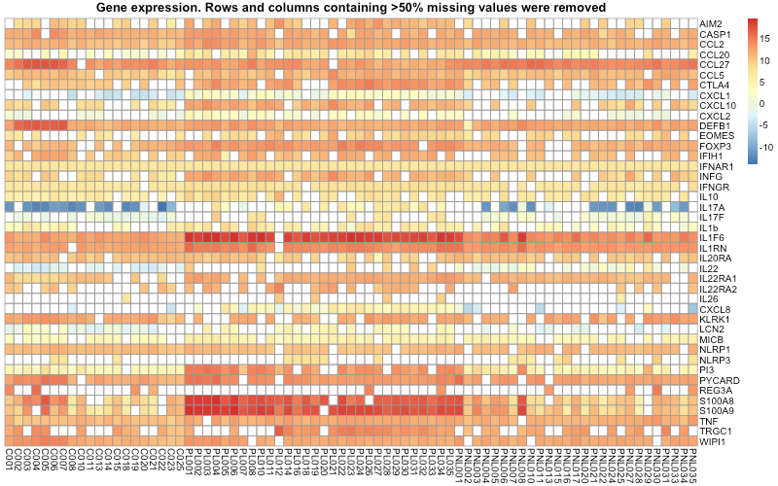
KNN
Gene expression matrix
Healthy people
Patients

Slide 23
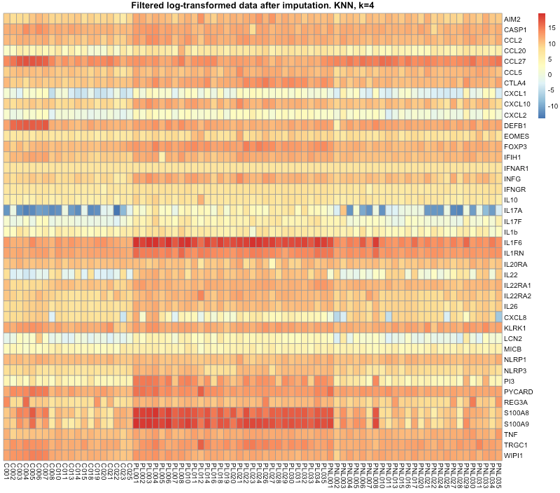
Imputed missing values
Gene expression matrix
Healthy people
Patients
Notes:
Input->out

Slide 24
Interpretation
Import
data
validation
Data
analysis
Summarize/
plot raw data
Handle
outliers
Impute missing values
Normalize/
Standardize

Slide 25
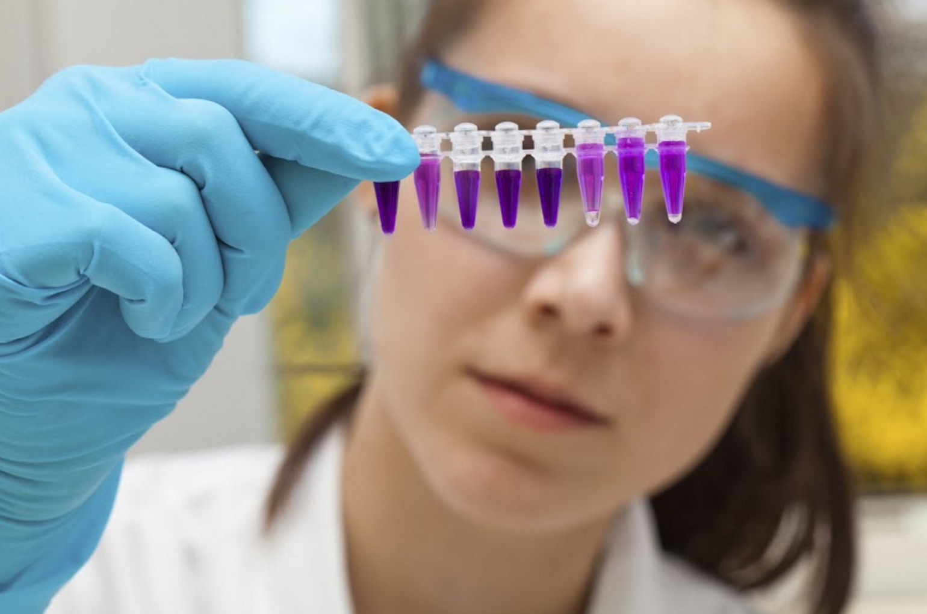

Technical vs Biological

Slide 26
Normalization & Standardization
Objective:
adjust measurements so that they can be appropriately compared among samples
Key ideas:
Remove technological biases
Make samples comparable
Methods:
Z-scores (centering and scaling)
Logarithmization
Quantile normalization
Linear model based normalization

Slide 27
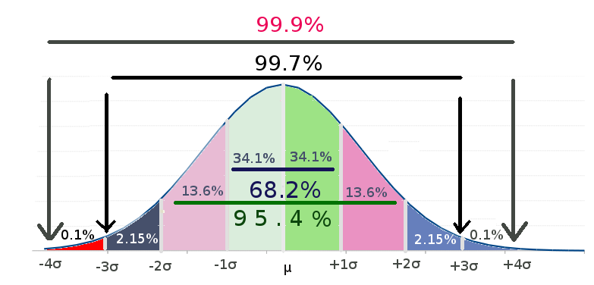
Z-scores
Centering a variable is subtracting the mean of the variable from each data point so that the new variable's mean is 0.
Scaling a variable is multiplying each data point by a constant in order to alter the range of the data.
where:
μ is the mean of the population.
σ is the standard deviation of the population.

Slide 28
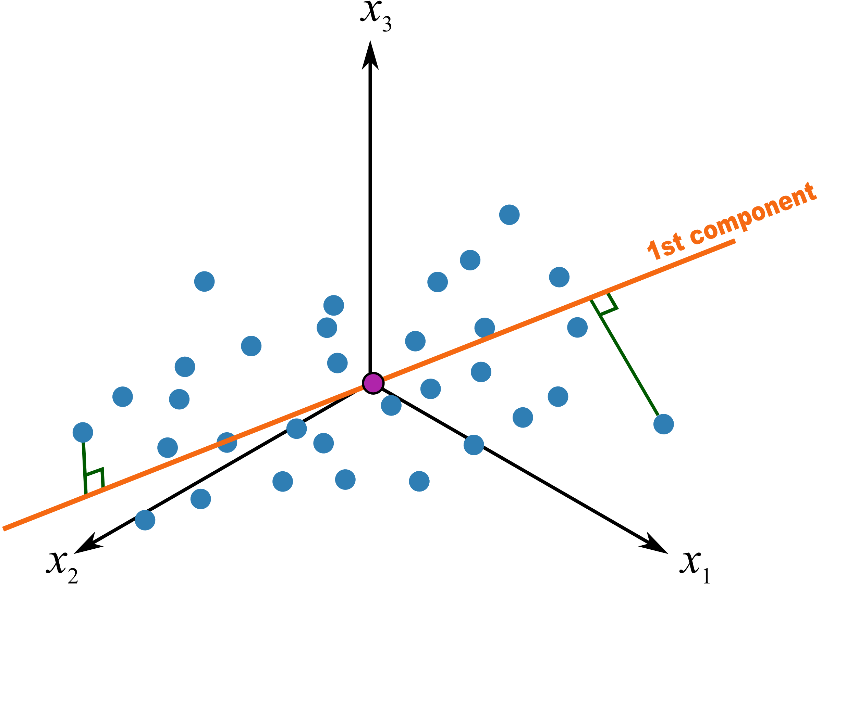
Principal Component Analysis
transforms the data by a linear projection onto a lower-dimensional space that preserves as much data variation as possible

Slide 29
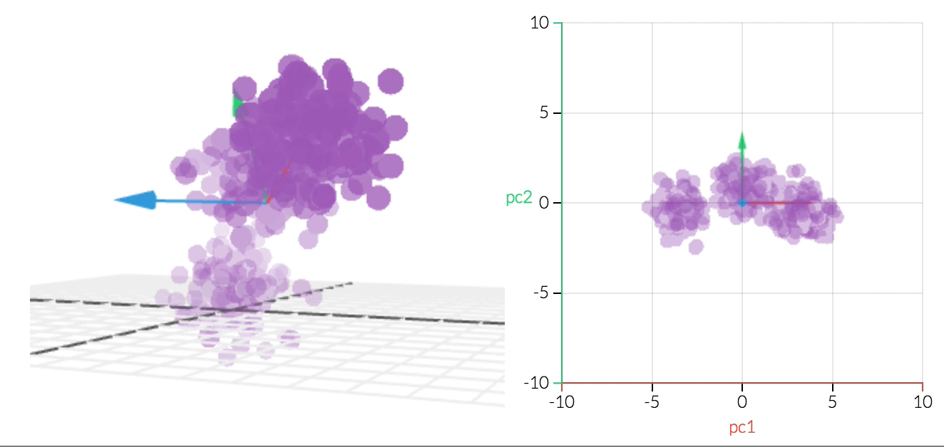
Principal Component Analysis
Objective:
Reduce dimensionality while preserving as much variance as possible
http://setosa.io/ev/principal-component-analysis/

Slide 30
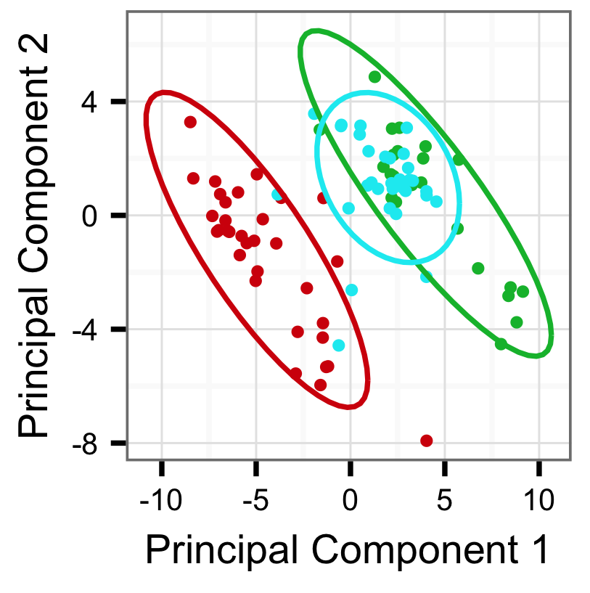

Visualize normalized data
Groups
Healthy
Patients group1
Patients group2

Slide 31
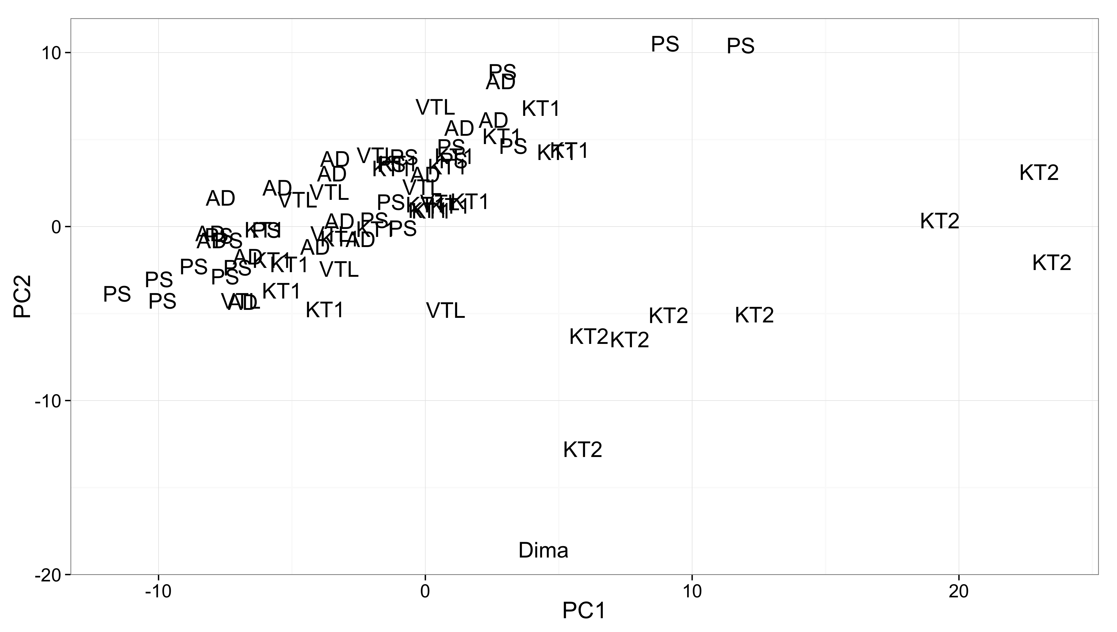
Visual inspection after normalization

Slide 32
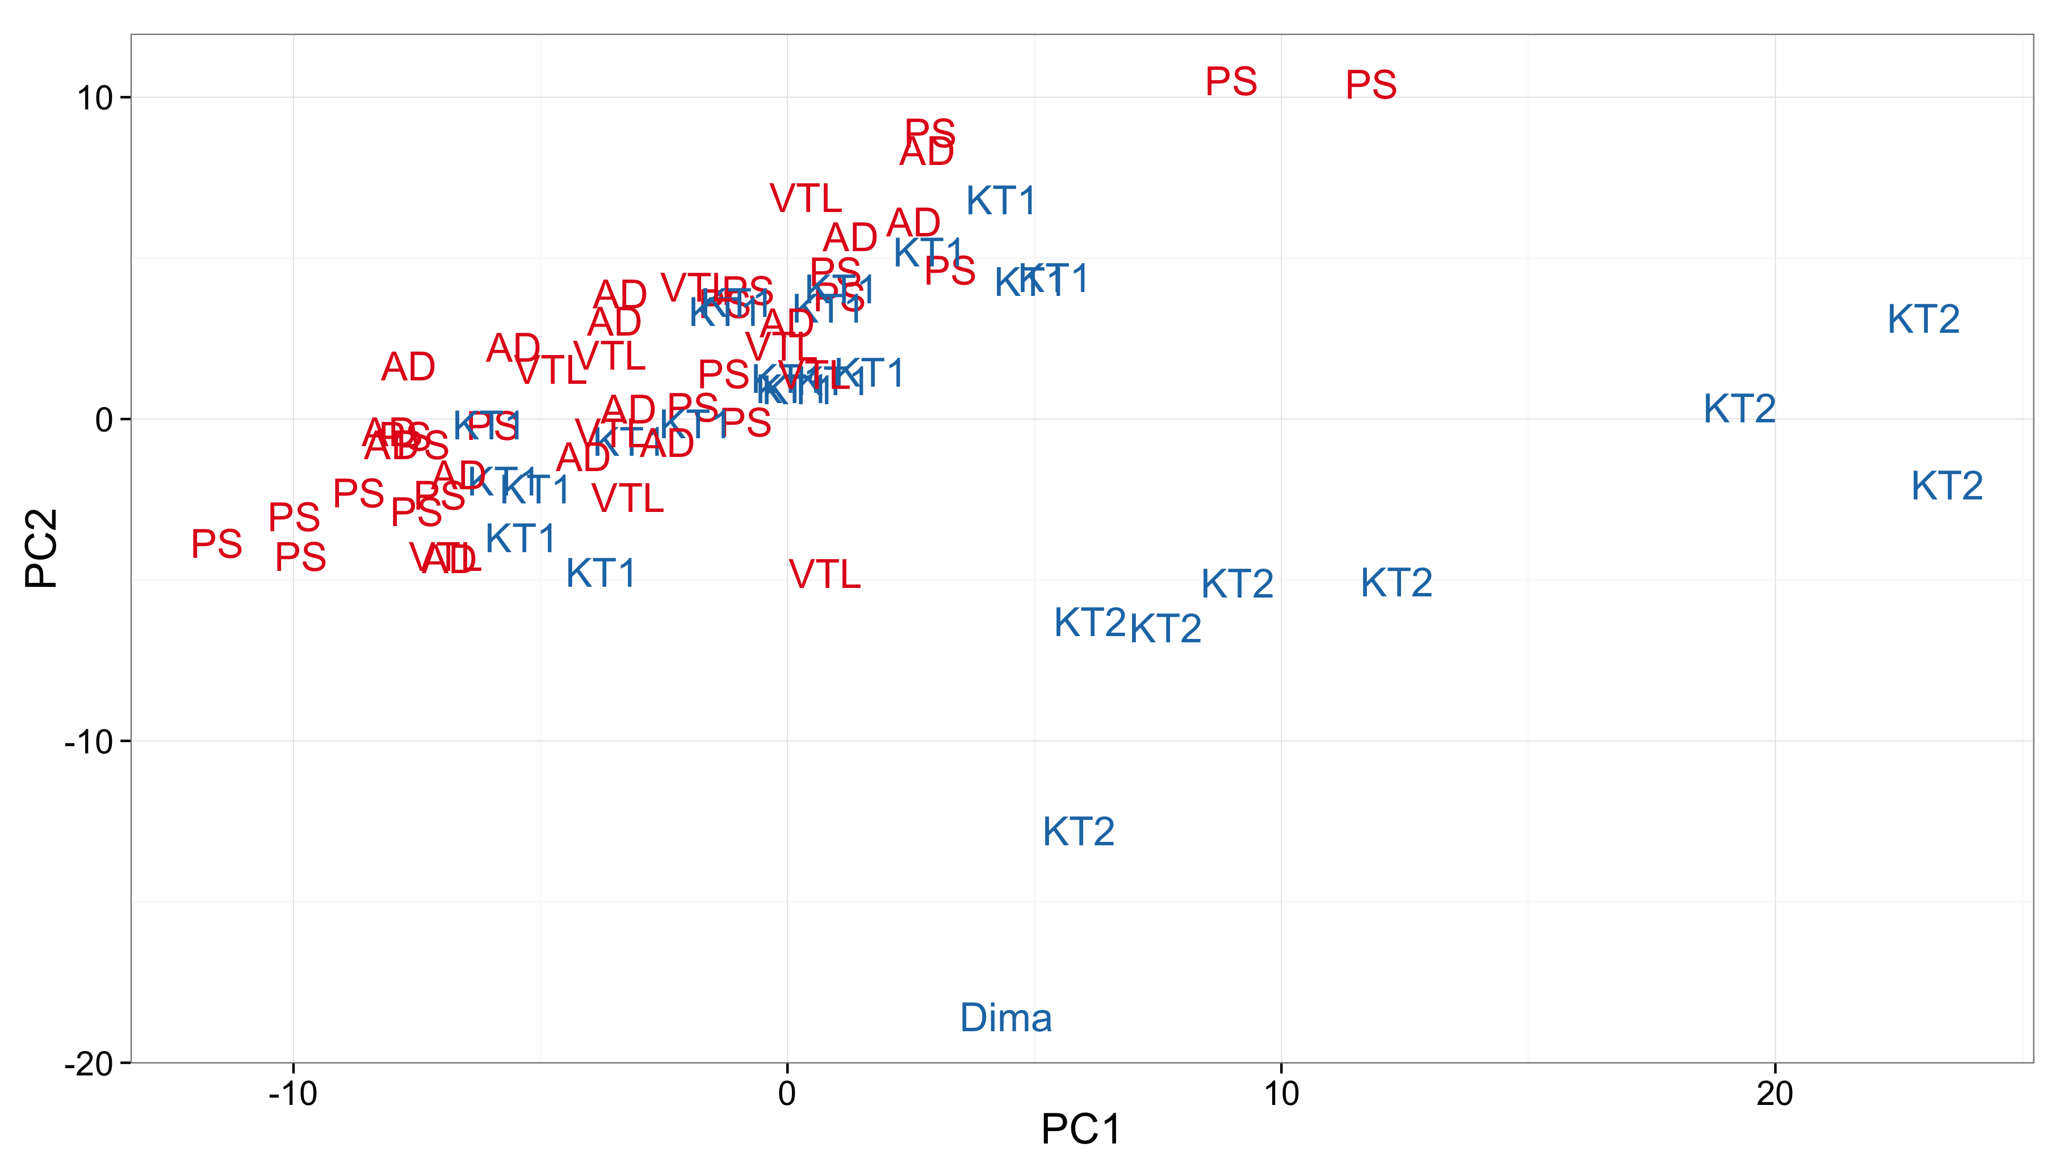
Visual Inspection. PCA
Patients
Healthy people
Highlight groups

Slide 33

Arrrgh!!!
Why aren’t you
together ?!?!

Slide 34
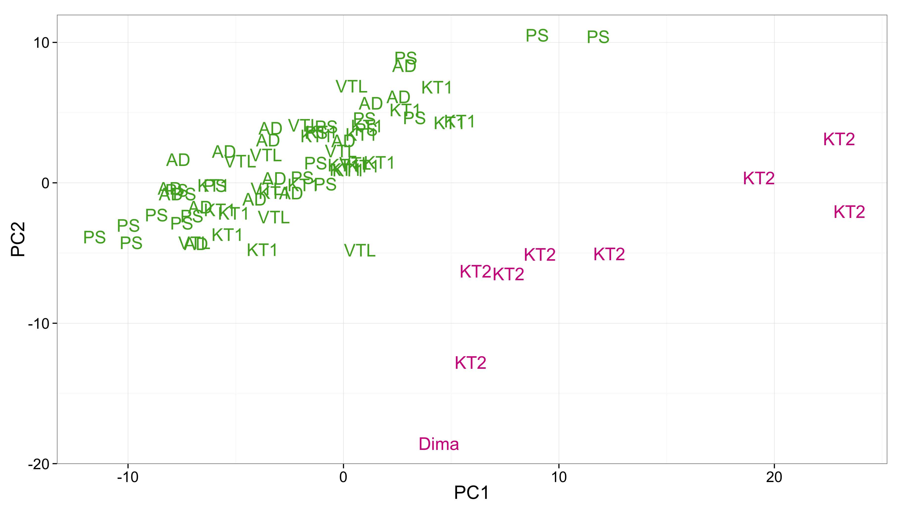
Visual Inspection. PCA
DAY1
DAY2
Color by experiment/dataset/day etc.

Slide 35
Batch Effects
are technical sources of variation that have been added to the samples during handling. They are unrelated to the biological or scientific variables in a study.
Measurements are affected by:
Laboratory conditions
Reagent lots
Personnel differences
Major problem :
might be correlated with an outcome of interest and lead to incorrect conclusions

Slide 36
Fighting The Batch Effects
Experimental design solutions:
Shorter experiment time
Equally distributed samples between multiple laboratories and across different processing times, etc.
Provide info about changes in personnel, reagents, storage and laboratories
Statistical solutions:
ComBat
SVA(Surrogate variable analysis, SVD+linear models)
PAMR (Mean-centering)
DWD (Distance-weighted discrimination based on SVM)
Ratio_G (Geometric ratio-based)
J.T. Leek, Nature Reviews Genetics 11, 733-739 (October 2010,) Chao Chen, PlosOne, 2011

Slide 37


Slide 38
Interpretation
Import
data
validation
Data
analysis
Summarize/
plot raw data
Handle
outliers
Impute missing values
Normalize/
Standardize

Slide 39
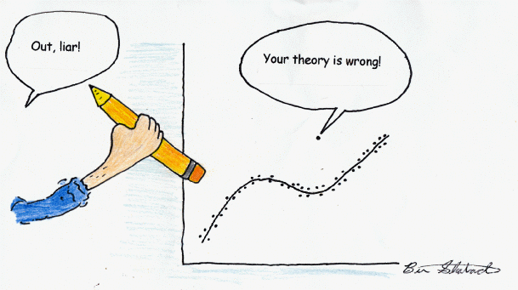
Outliers Detection

Slide 40
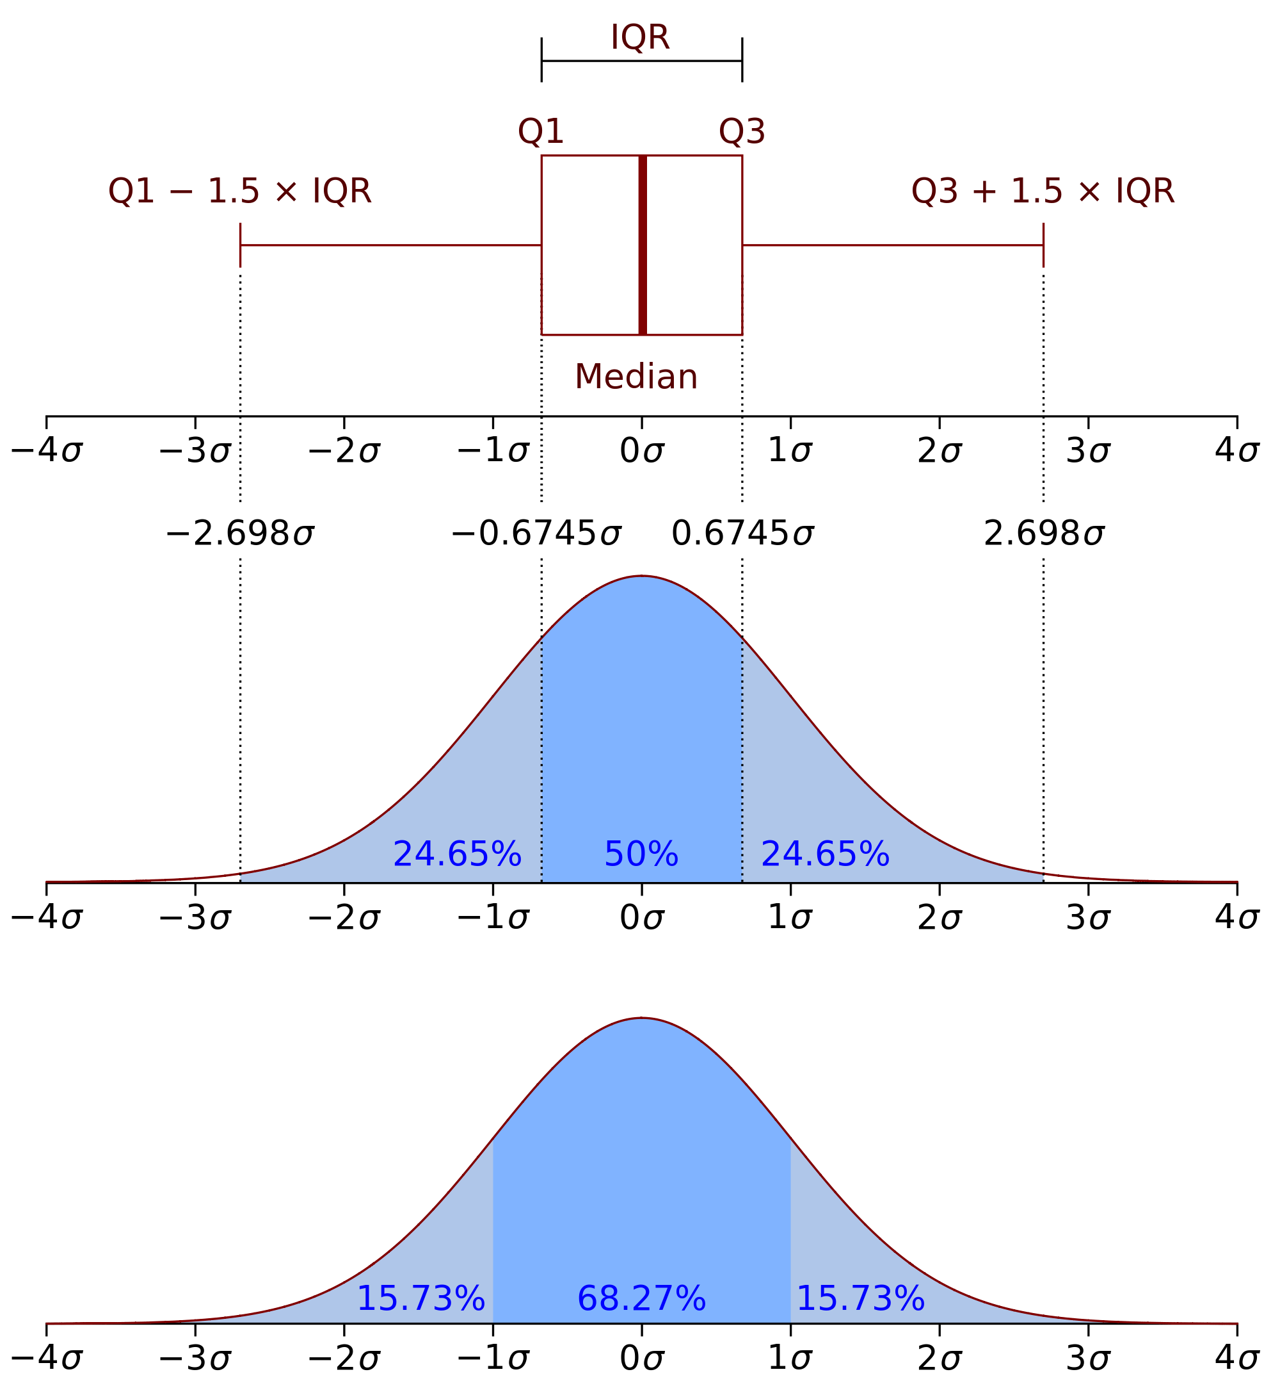
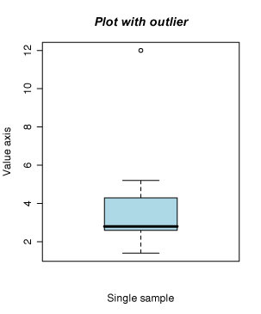
Interquartile rate
outlier

Slide 41


Slide 42
Interpretation
Import
data
validation
Data
analysis
Summarize/
plot raw data
Handle
outliers
Impute missing values
Normalize/
Standardize

Slide 43
IF YOU TORTURE THE DATA LONG ENOUGH IT WILL CONFESS TO ANYTHING
Ronald Coase, Economist, Nobel Prize winner

Slide 44
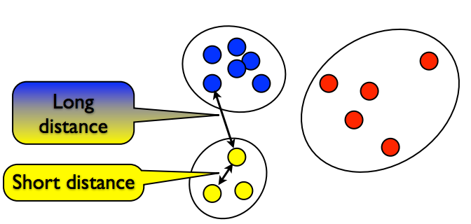
What is cluster analysis?
Clustering is ﬁnding groups of objects such that:
similar (or related) to the objects in the same group and
different from (or unrelated) to the objects in other groups

Slide 45
Properties
Classes/labels for each instance are derived only from the data
For that reason, cluster analysis is referred to as unsupervised classification

Slide 46
Why to cluster biological data?
Intuition building
Finding hidden internal structure of the high-dimensional data
Hypothesis generation
Finding and characterizing similar groups of objects in the data
Knowledge discovery in data
Ex. Underlying rules, reoccurring patterns, topics, etc.
Summarizing / compressing large data
Data visualization

Slide 47
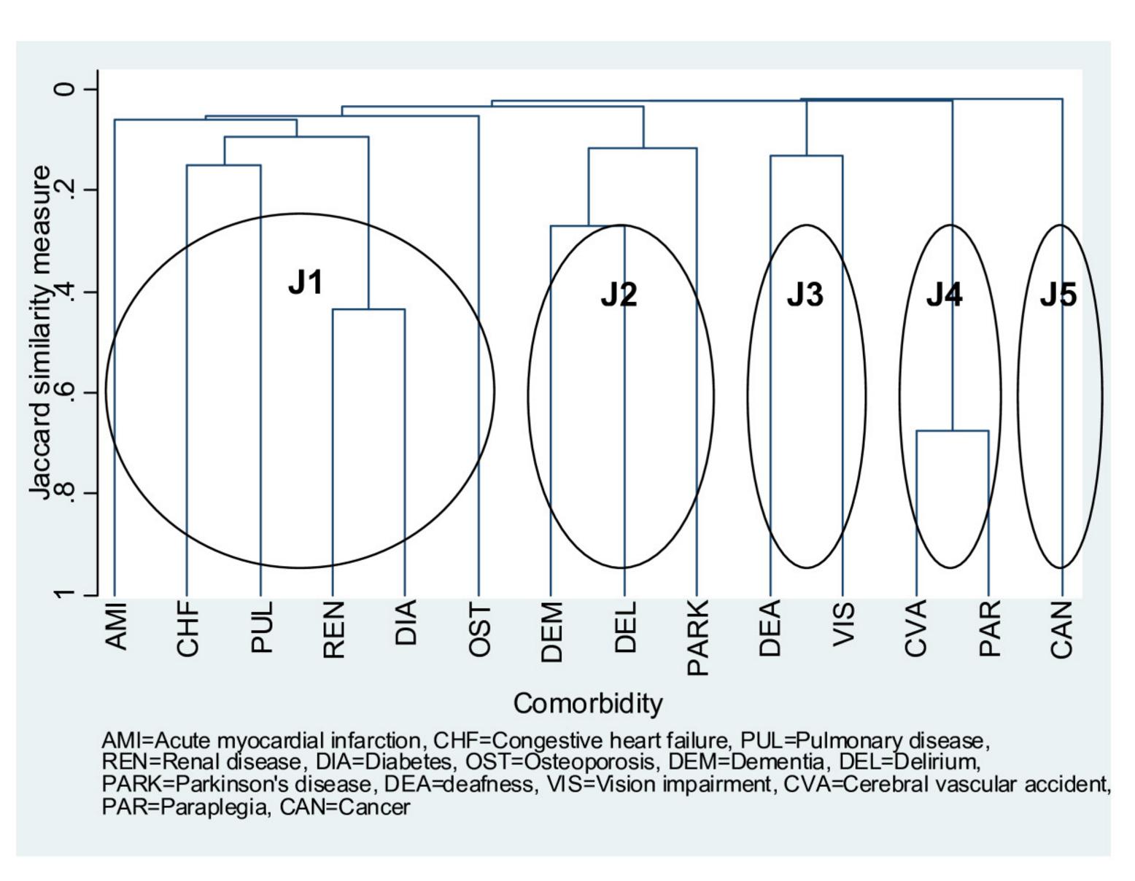
Intuition building
presence of one or more additional diseases or disorders co-occurring with a primary disease or disorder
cerebral vascular accident
cardiopulmonary/metabolic
disorders
neurological diseases
cancer
sensory conditions
http://bmcgeriatr.biomedcentral.com/articles/10.1186/1471-2318-11-45

Slide 48
Why to cluster biological data?
Intuition building
Finding hidden internal structure of the high-dimensional data
Hypothesis generation
Finding and characterizing similar groups of objects in the data
Knowledge discovery in data
Ex. Underlying rules, reoccurring patterns, topics, etc.
Summarizing / compressing large data
Data visualization

Slide 49
Hypothesis generation
SAHA
Trichostatin A
Valproic acid
Cyproconazole
PCB180
PCB170
CdCl₂
As₂O ₃
Triadimenol
Triadimefon
PCB153
Tubacin
MeHg
Rotenon
Pb-acetate
Mannitol
Thimerosal
HDACi
-3 -2 -1 0 1 2 3
Color coded scaled fold change (FC) vs control

Slide 50
Why to cluster biological data?
Intuition building
Finding hidden internal structure of the high-dimensional data
Hypothesis generation
Finding and characterizing similar groups of objects in the data
Knowledge discovery in data
Ex. Underlying rules, reoccurring patterns, topics, etc.
Summarizing / compressing large data
Data visualization

Slide 51
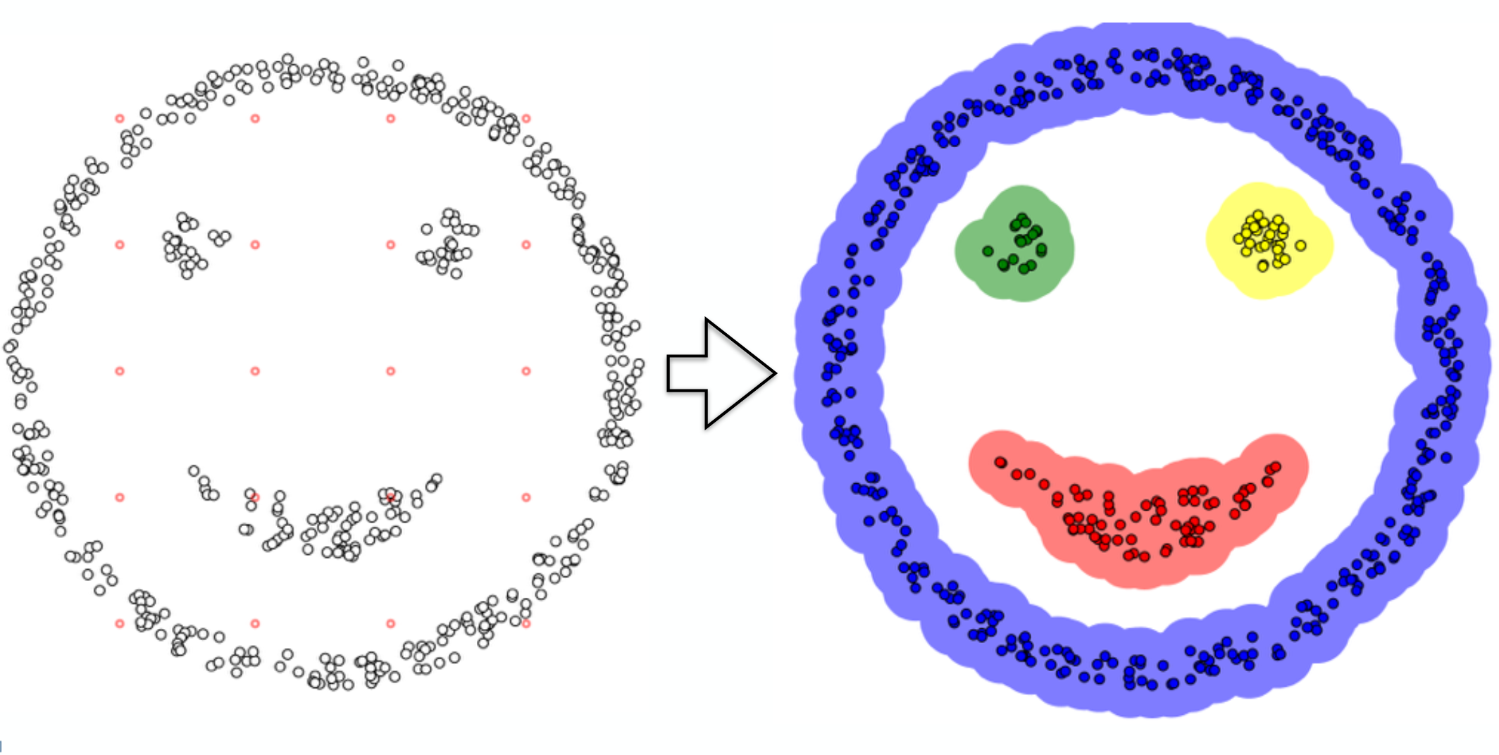
Knowledge discovery in data
Ex. Underlying rules, reoccurring patterns, topics, etc.

Slide 52
Why to cluster biological data?
Intuition building
Finding hidden internal structure of the high-dimensional data
Hypothesis generation
Finding and characterizing similar groups of objects in the data
Knowledge discovery in data
Ex. Underlying rules, reoccurring patterns, topics, etc.
Summarizing / compressing large data
Data visualization

Slide 53
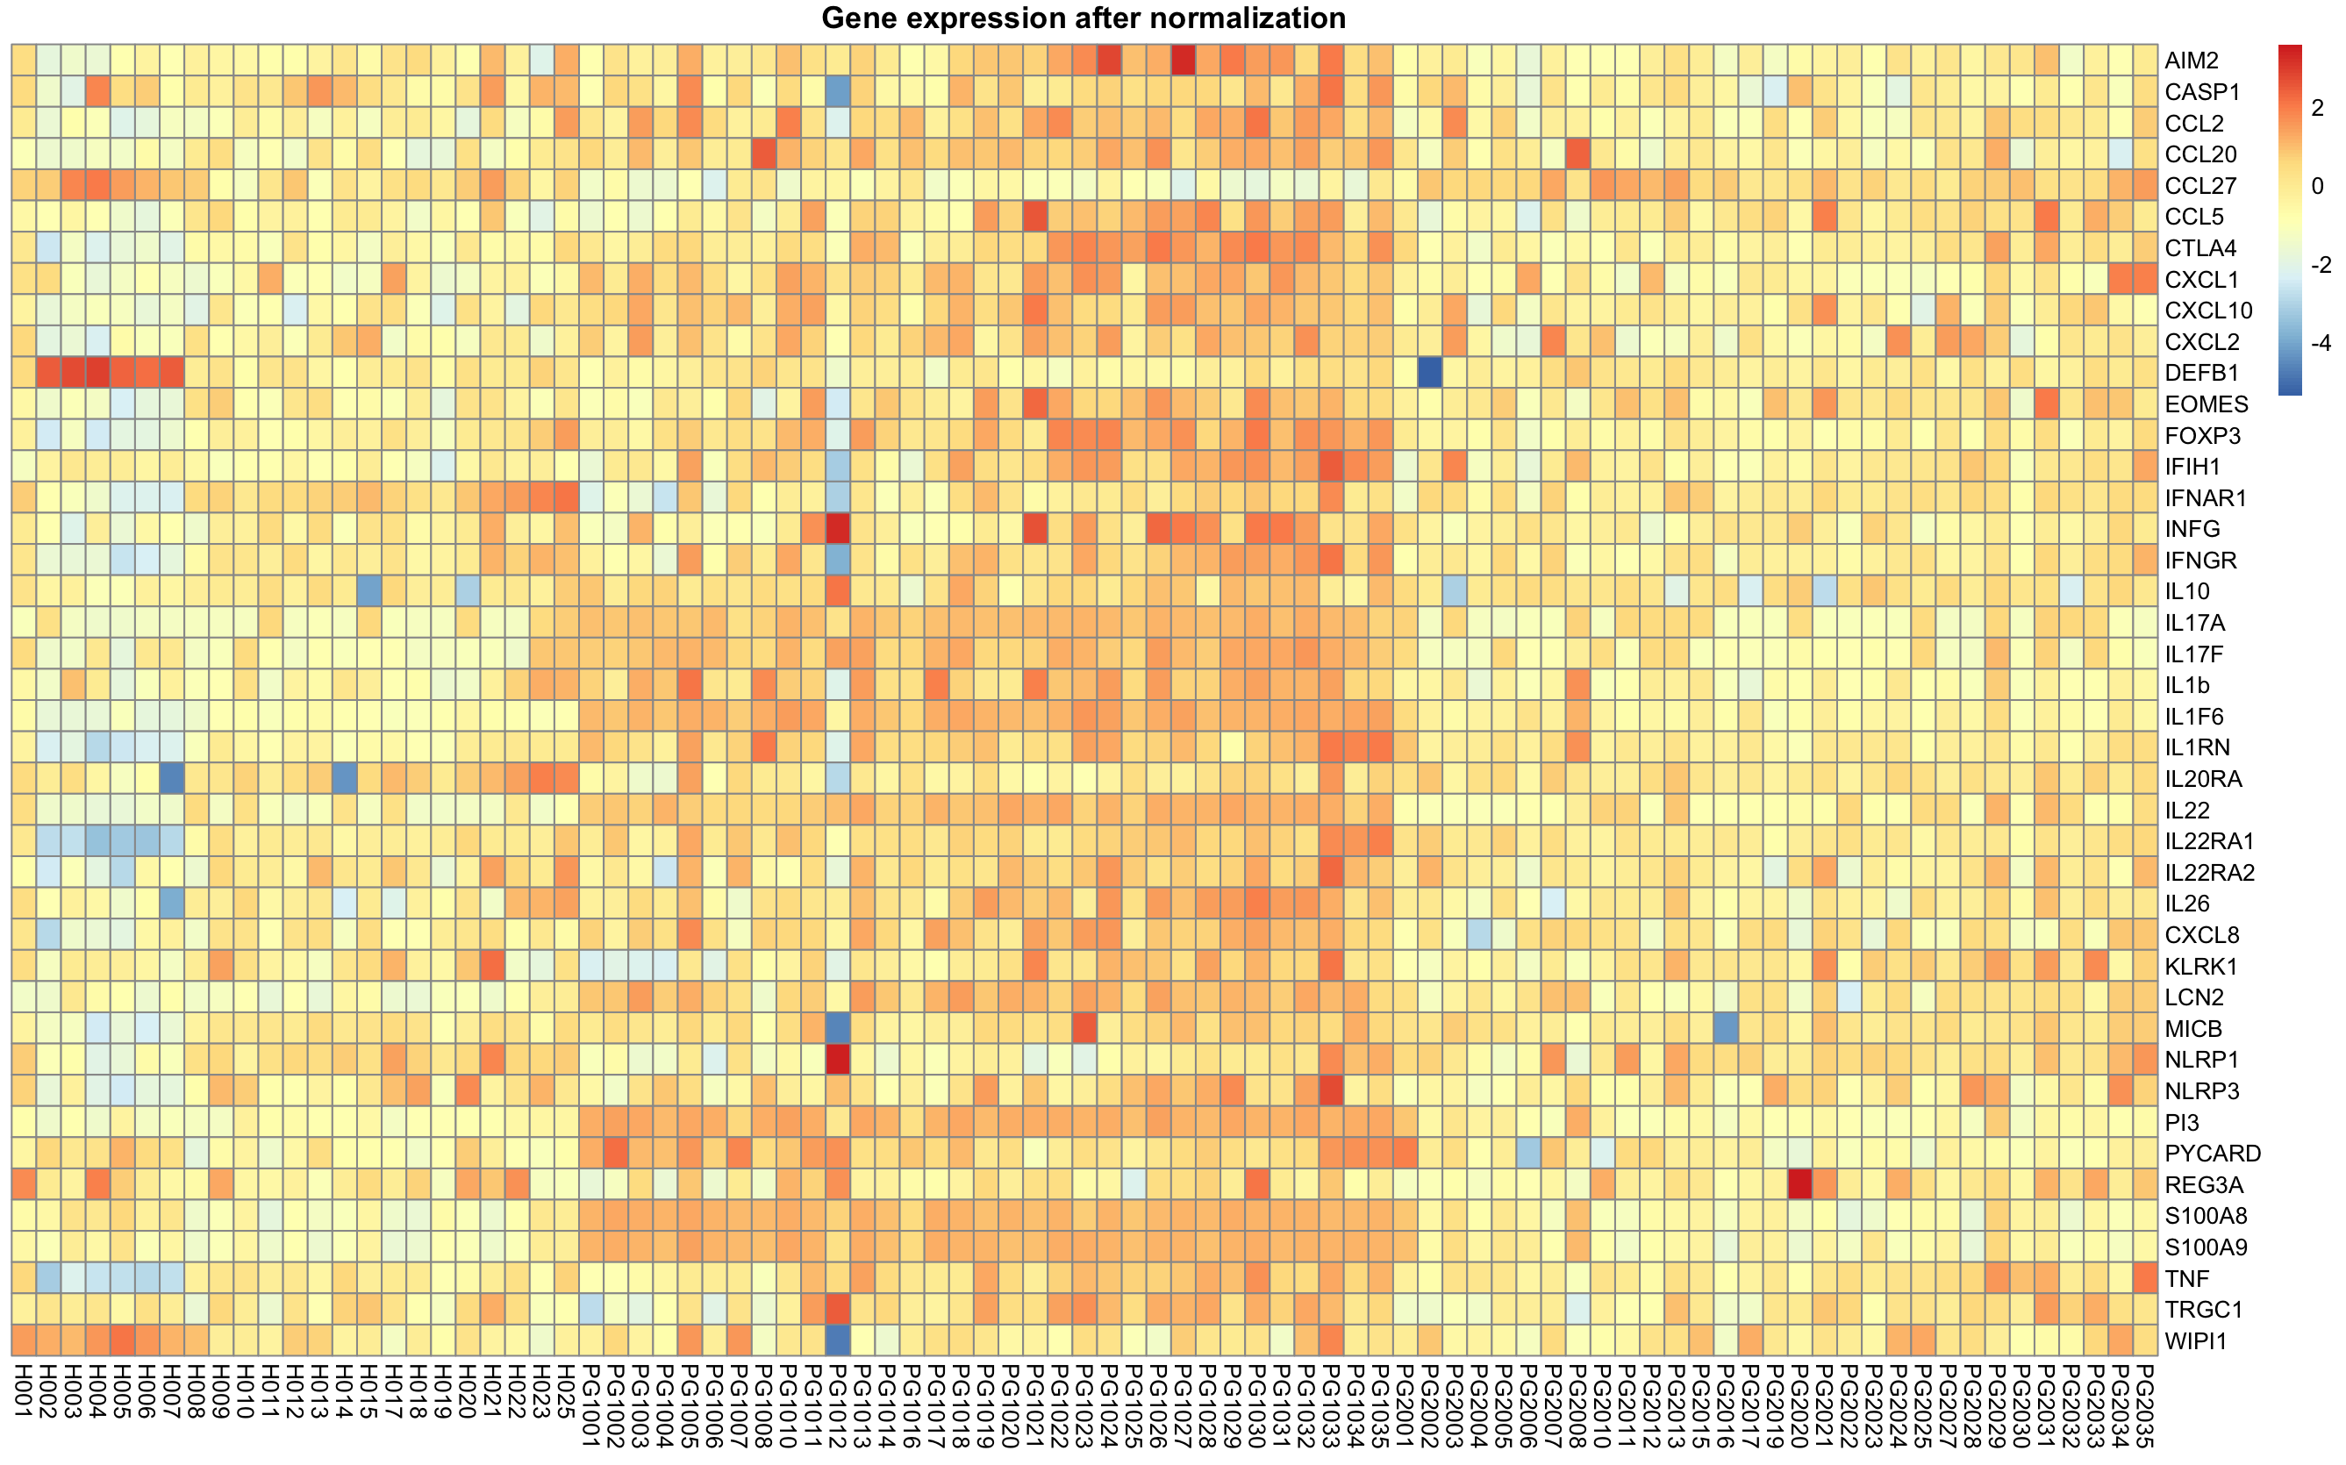
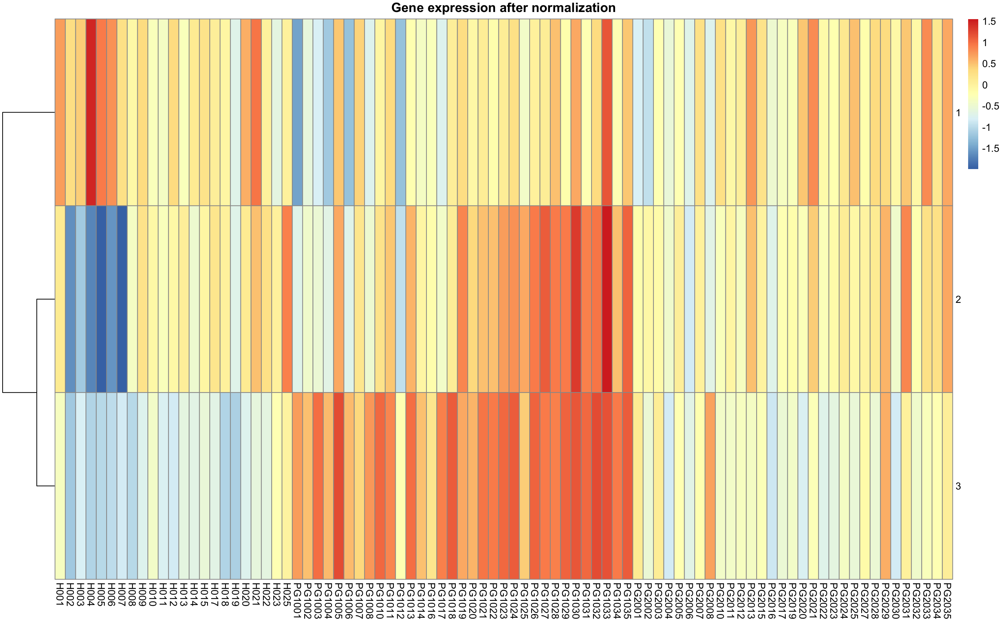
Summarizing/compressing the data

Slide 54
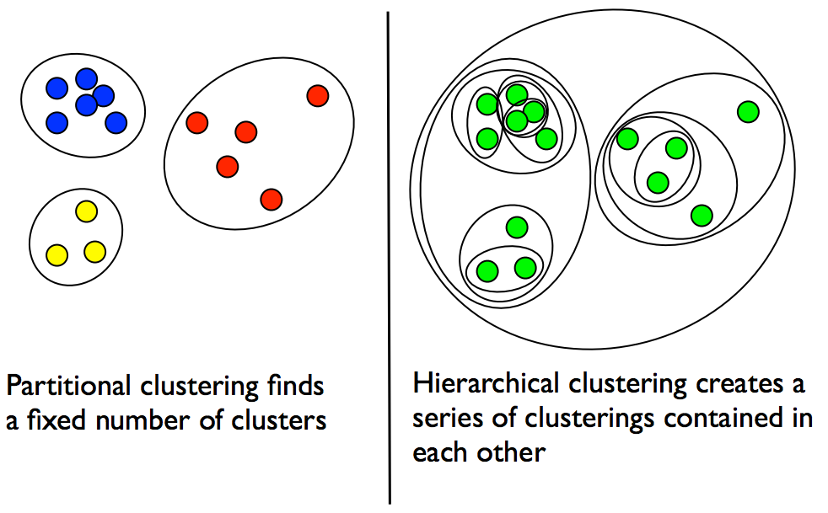
Partitional vs Hierarchical
Each sample(point) is assigned to a unique cluster
Creates a nested and hierarchical set of partitions/clusters

Slide 55
Fuzzy vs Non-Fuzzy
Each object belongs to each cluster with some weight
Each object belongs to
exactly one cluster

Slide 56
Hierarchical clustering
Hierarchical clustering is usually depicted as a dendrogram (tree)

Slide 57
Hierarchical clustering
Each subtree corresponds to a cluster
Height of branching shows distance

Slide 58
Hierarchical clustering
Algorithm for Agglomerative Hierarchical Clustering:
Join the two closest objects

Slide 59
Hierarchical clustering
Join the two closest objects

Slide 60
Hierarchical clustering
Keep joining the closest pairs

Slide 61
Hierarchical clustering
Keep joining the closest pairs

Slide 62
Hierarchical clustering
Keep joining the closest pairs

Slide 63
Hierarchical clustering
Keep joining the closest pairs

Slide 64
Hierarchical clustering
After 10 steps we have 4 clusters left

Slide 65
Q: Which clusters do we merge next?

Slide 66
Hierarchical clustering
Several ways to measure distance between clusters:
Single linkage(MIN)

Slide 67
Hierarchical clustering
Several ways to measure distance between clusters:
Single linkage(MIN)
Complete linkage(MAX)

Slide 68
Hierarchical clustering
Several ways to measure distance between clusters:
Single linkage (MIN)
Complete linkage (MAX)
Average linkage
Weighted
Unweighted ...
Ward’s method

Slide 69
Hierarchical clustering
In this example and at this stage we have the same result as in partitional clustering

Slide 70
Hierarchical clustering
In the final step the two remaining clusters are joined into a single cluster

Slide 71
Hierarchical clustering
In the final step the two remaining clusters are joined into a single cluster

Slide 72
Examples of Hierarchical
Clustering in Bioinformatics

Slide 73
K-means clustering
Partitional, non-fuzzy
Partitions the data into K clusters
K is given by the user
Algorithm:
Choose K initial centers for the clusters
Assign each object to its closest center
Recalculate cluster centers
Repeat until converges

Slide 74
K-means (1)

Slide 75
K-means (2)

Slide 76
K-means (3)

Slide 77
K-means (4)

Slide 78
K-means (5)

Slide 79
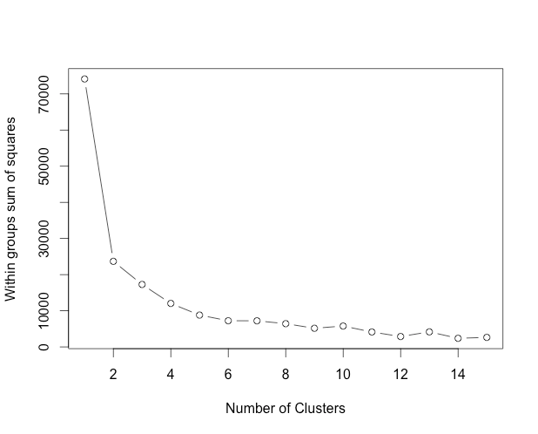
Elbow method
Estimate the number of clusters

Slide 80
K-means clustering summary
One of the fastest clustering algorithms
Therefore very widely used
Sensitive to the choice of initial centres
many algorithms to choose initial centres cleverly
Assumes that the mean can be calculated
can be used on vector data
cannot be used on sequences
(what is the mean of A and T?)

Slide 81
K-medoids clustering
The same as K-means, except that the center is required to be at an object
Medoid - an object which has minimal total distance to all other objects in its cluster
Can be used on more complex data, with any distance measure
Slower than K-means

Slide 82
K-medoids (1)

Slide 83
K-medoids (2)

Slide 84
K-medoids (3)

Slide 85
K-medoids (4)

Slide 86
K-medoids (5)

Slide 87
K-medoids (6)

Slide 88
K-medoids (7)

Slide 89
K-medoids (8)

Slide 90
K-medoids (9)

Slide 91
Examples of K-means and
K-medoids in Bioinformatics

Slide 92
Distance measures

Slide 93


Slide 94
Interpretation
Import
data
validation
Data
analysis
Summarize/
plot raw data
Handle
outliers
Impute missing values
Normalize/
Standardize

Slide 95
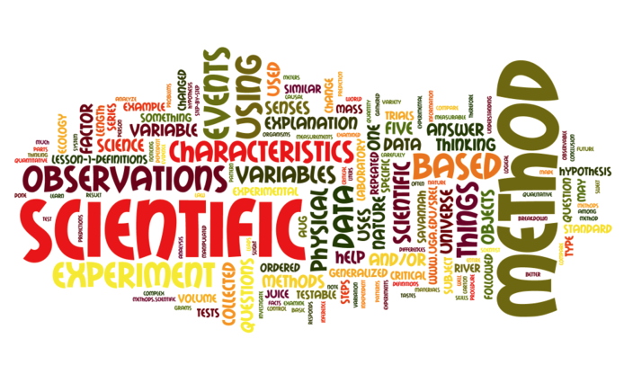
Put it into words & Discover
https://mastrianascience.wikispaces.com/file/view/scientific_method_wordle.png/253466620/694x406/scientific_method_wordle.png

Slide 96

Gene ontology
What found genes are doing
Molecular Function - elemental activity or task
• Biological Process - broad objective or goal
• Cellular Component - location or complex

Slide 97
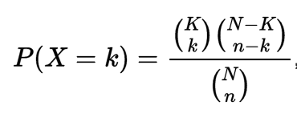
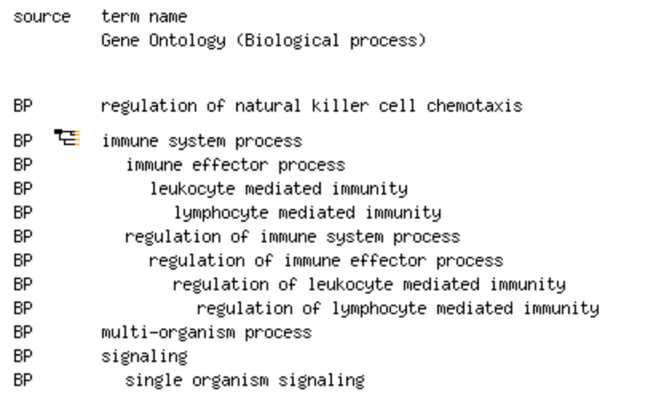
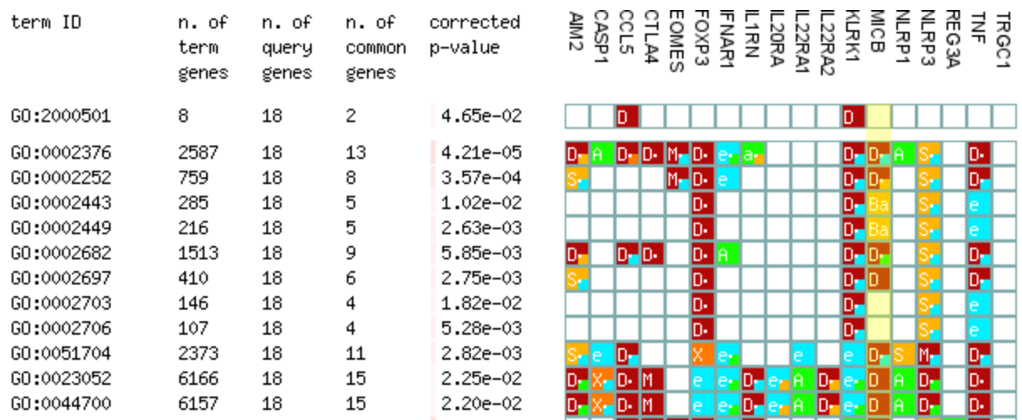
Functional annotations & Significance
statistical significance of having drawn a sample consisting of a specific number of k successes out of n total draws from a population of size N containing K successes.

Slide 98
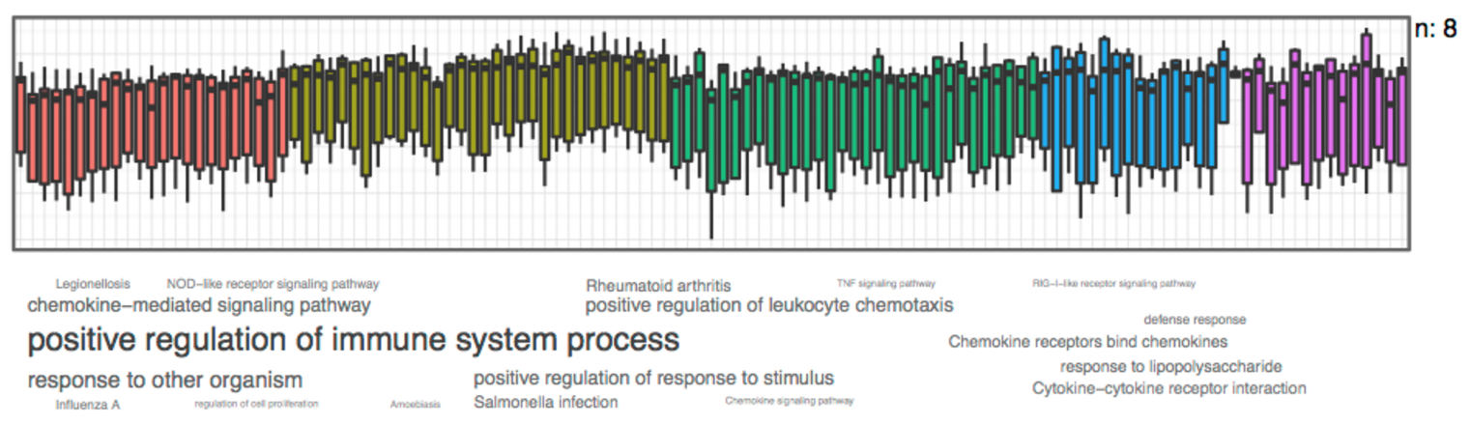
Cluster annotation
GOsummaries
https://www.bioconductor.org/packages/release/bioc/html/GOsummaries.html

Slide 99

Practice time!

